Slide 1
SOPHISTICATED IMAGE
Capstone II Final Project
Whitney Jackson

Slide 2
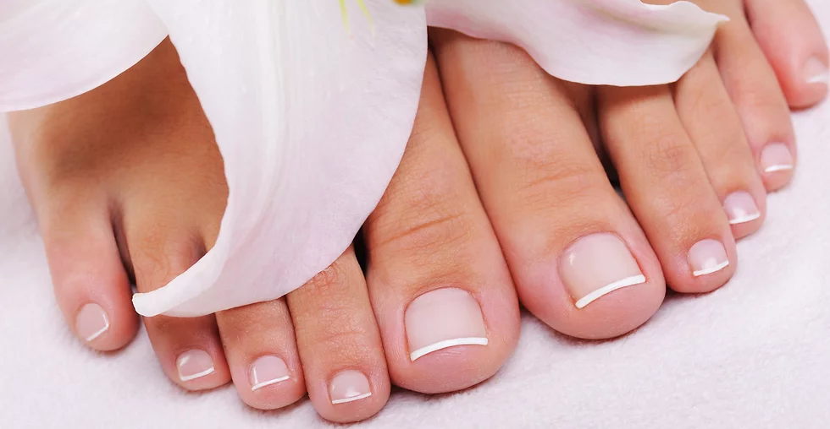
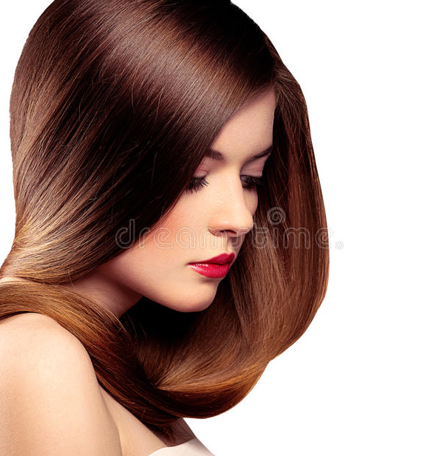
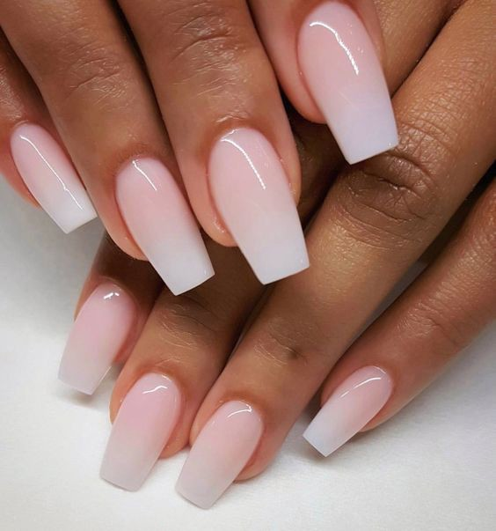
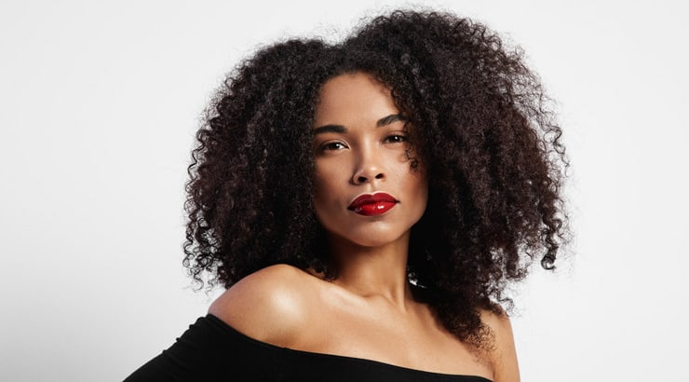
Agenda
Topic one: Home
Topic two: About
Topic three: Blog
Topic four: Service/Contact
Topic five: Shopping Cart

Slide 3
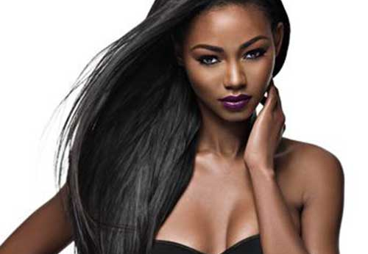
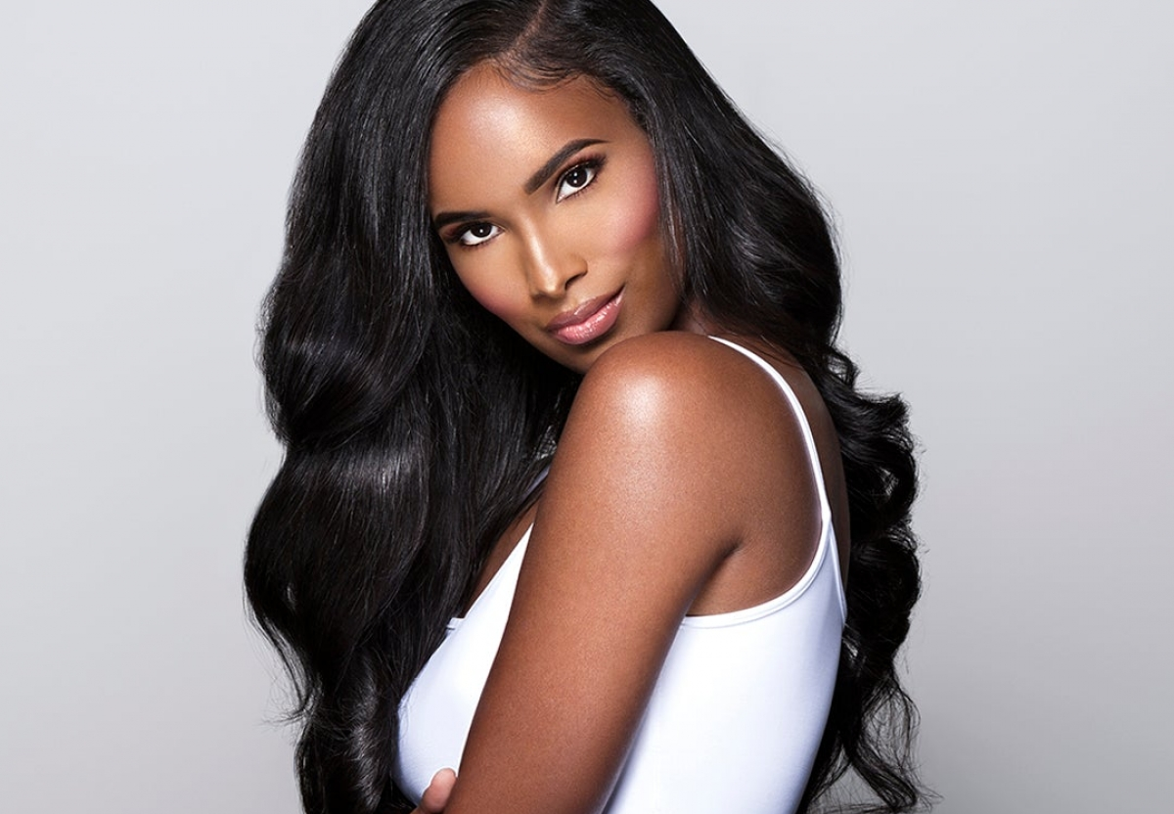
Introduction
Welcome to my final Capstone II project. I hope you enjoy my presentation and find my final website very useful and exciting! I’ll be demonstrating how my website works, while navigating you through every area.

Slide 4
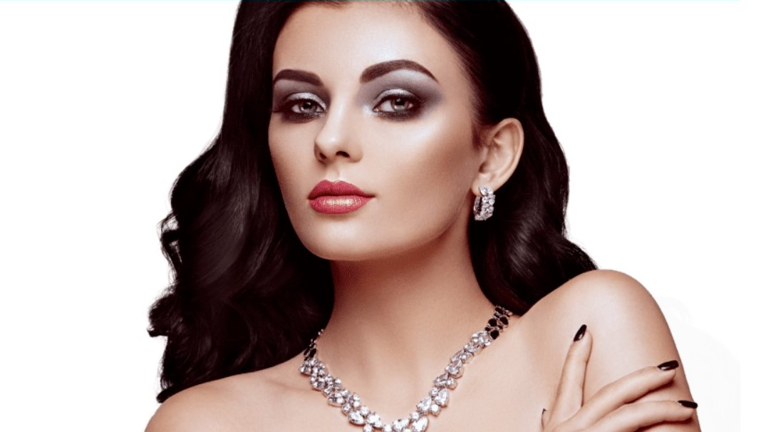
Home
About
Blog/Staff
Services
Contact
Shop

Slide 5

Home Page
Welcome to my home page. My home page introduces the title of the website and the slogan. You’ll see a link to a YouTube video and different other links that’ll navigate you to other pages.

Slide 6
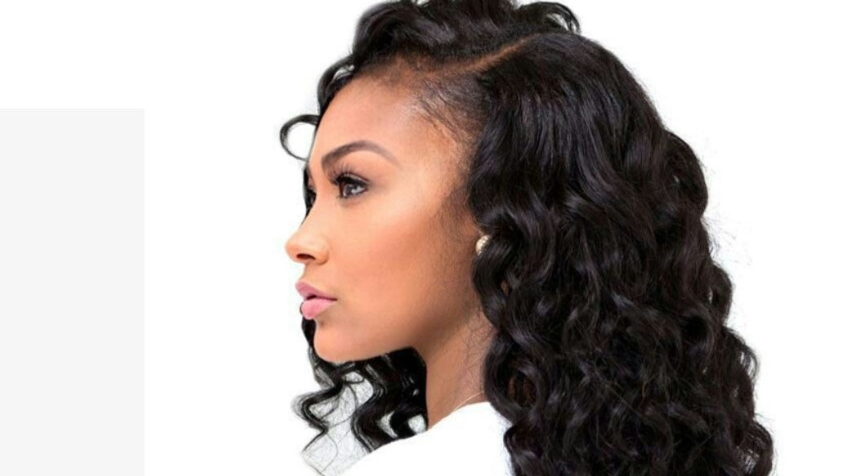
About Us Give the viewers an insight about the history of SI and introduce the viewers to the team and what role each team member preforms.

Slide 7
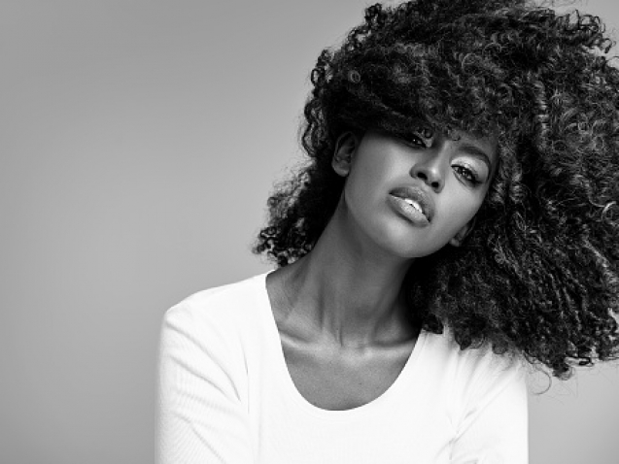
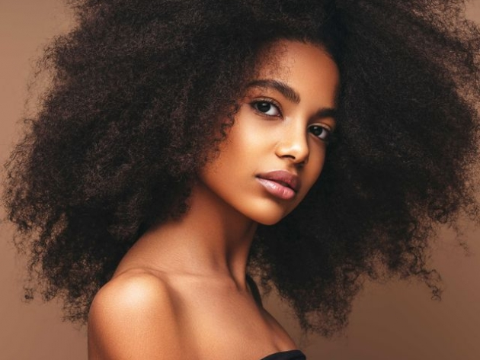
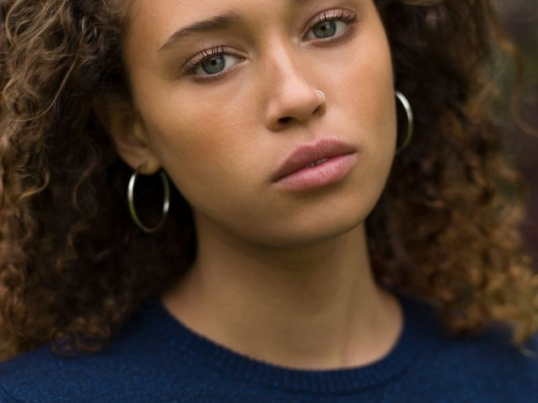
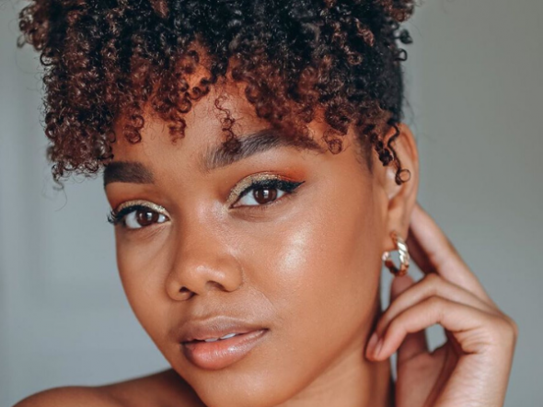
Meet The S.I Team
Whitney Jackson
De’Asya Johnson
Brooklyne Jackson
Ashley Dixon
CEO & Founder
Hair Stylist
Nail Tech
Make-up Artist

Slide 8
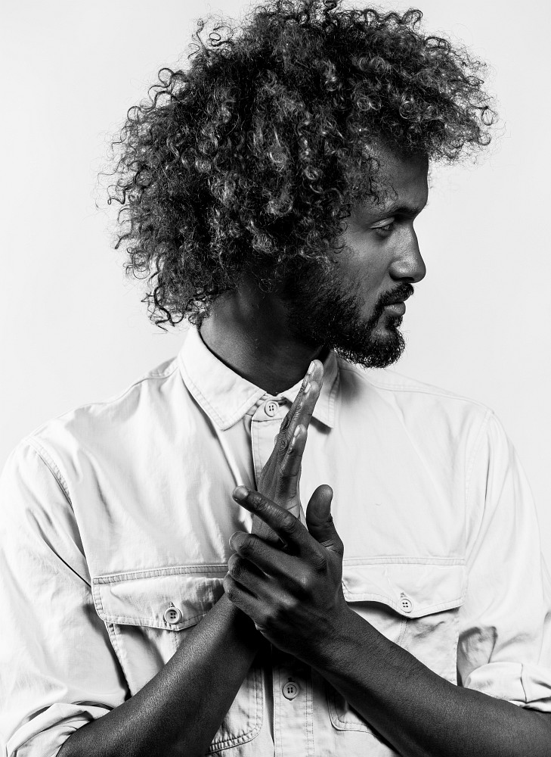
Gallery
Our gallery showcases our amazing work. Photos are taken of before and after services. With permission from our clients, we’re allowed to feature them in our online gallery. This allows customers to get a feel of what we can do and allow us to advertise our portfolio.

Slide 9
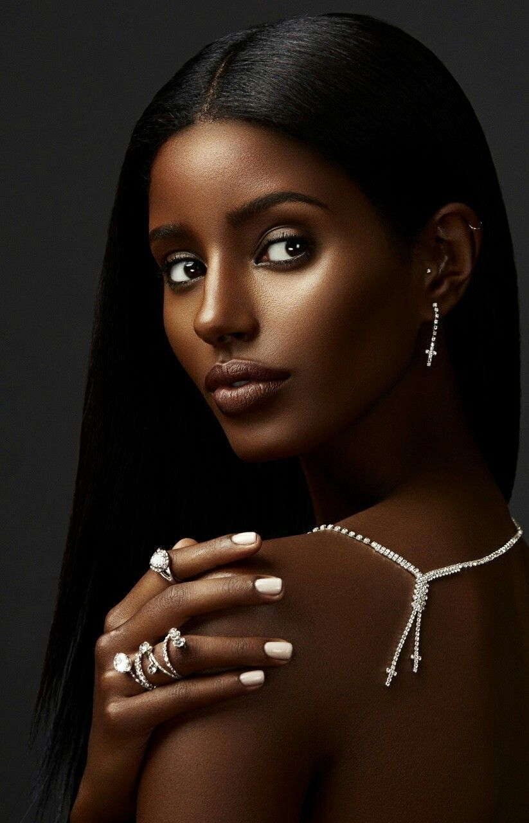
BLOG
The blog page is for customers to gain more knowledge on beauty tips . Each week our blog page is updated with Q&A’s, tips and the latest updates on upcoming products. The blog will feature three topics. Beauty, Nails and Hairstyles.

Slide 10
Healthy Blog Tips
Healthy Nail Tips
Nails reflect our overall health, which is why proper nail care is so important. Here are dermatologists’ tips for keeping your nails healthy:.
Natural Hair Tips
You’ll definitely notice a difference in the natural texture of your hair and your relaxed hair. Relaxers weaken your hair, leaving it dull and damaged over time. So, the difference should be fairly obvious.
Natural Hair Tips
Natural hair is relaxer-free hair that hasn’t been chemically straightened with a relaxer. When you have natural hair, you’re wearing your hair in its natural state..
Healthy Nail Tips
Healthy Skin Tips
Cut nails straight across. Use sharp nail scissors or clippers. Round the nails slightly at the tips for maximum strength.
Skin protects your body in many ways. “The skin provides a barrier to protect the body from invasion by bacteria and other possible environmental hazards that can be dangerous for human health,” says NIH dermatologist Dr. Heidi Kong.

Slide 11
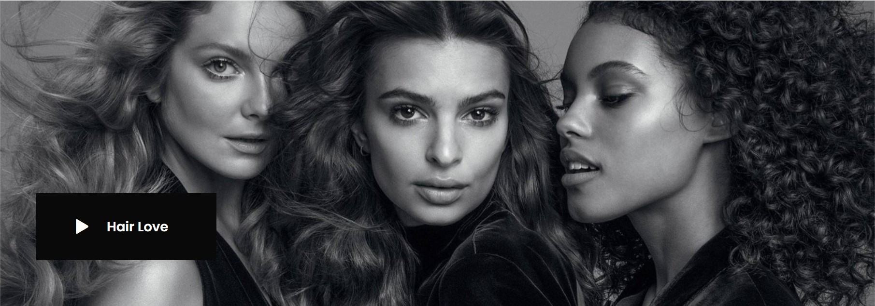

YouTube Videos
Each photo is linked to a different YouTube video. The purpose of the YouTube video is to broadcast our talent all around the world through videos and not just photos

Slide 12
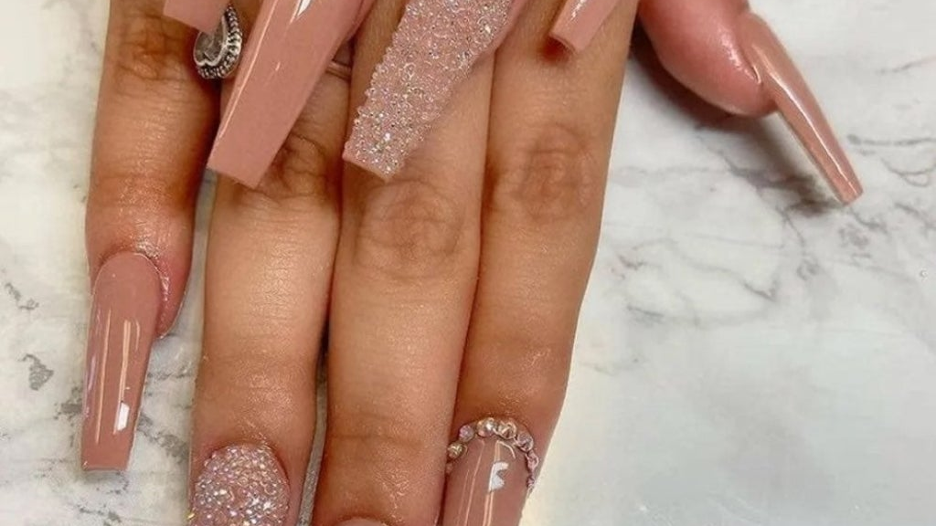
S.I Services
Provides our customers a list of our prices. S.I provides three categories. The list of prices are open to the public, online and in the salon. Here are some of our prices.

Slide 13
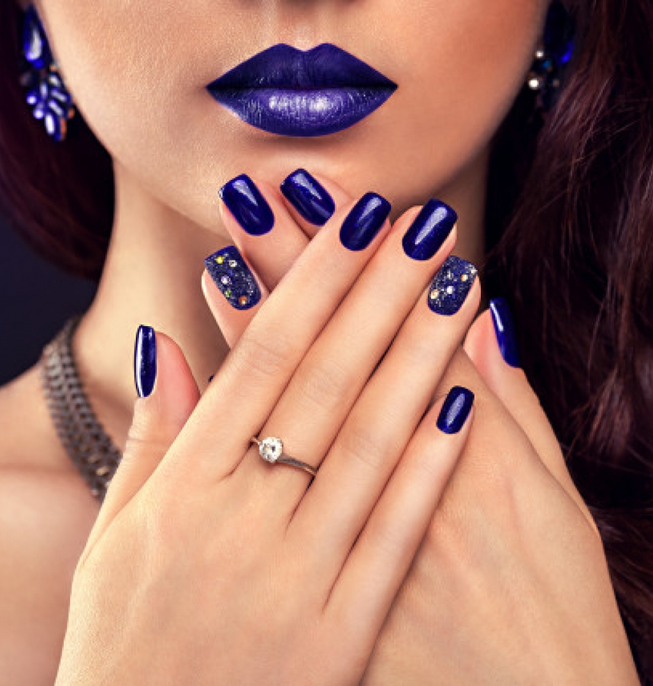
Nails Services
MANICURE $18.
PEDICURE $38.
FULL SET $32.
FILL $22
GEL PEDICURE $52

Slide 14
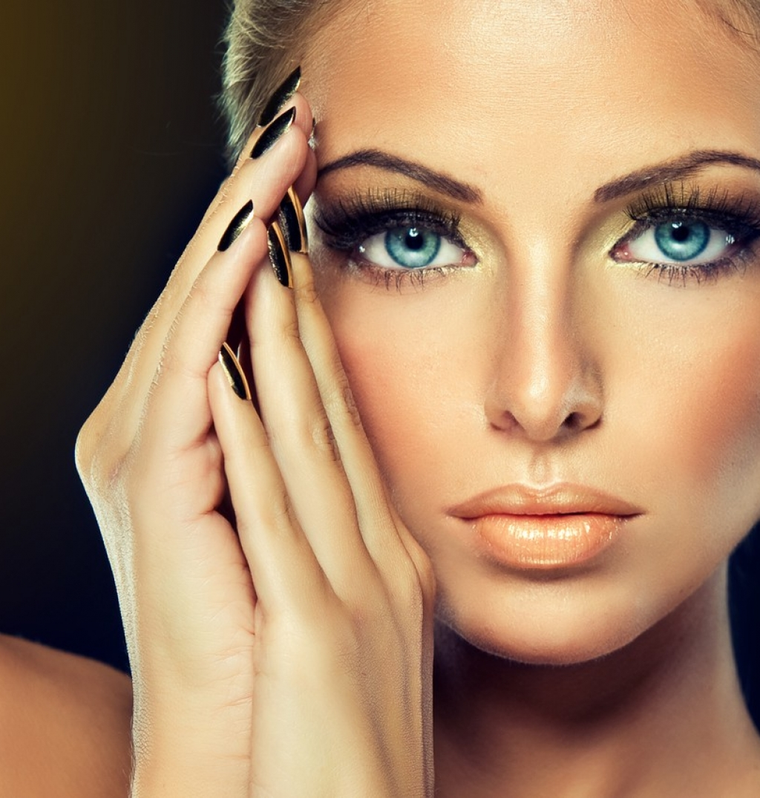
Make-Up Services
Full Face
FULL FACE $50
Prom
Prom $50
Facial
FACIAL $60.
Lip Wax
LIP WAX $10
Eyebrows
EYEBROWS $25

Slide 15
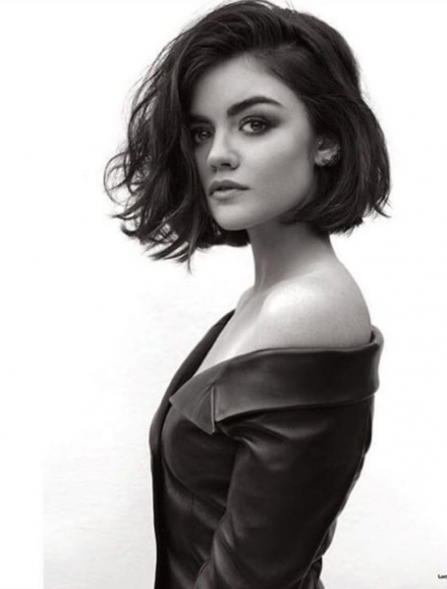
Hair Style Services
SILKOUT $60
ROLLERSET $55
TRIM $15
CUT & STYLES $70
QUICK WEAVE $80

Slide 16
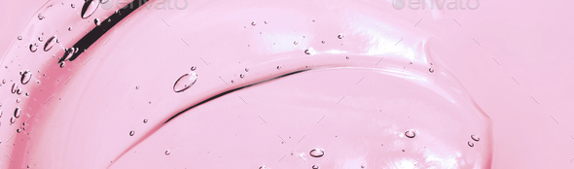





Shopping Cart
Wigs are non-refundable
All payments are accepted
Purchase as many items as you want
Store items in shopping cart for later
Shop for wigs, hair products and bundles

Slide 17
Thank you
Whitney Jackson
Capstone II
web-projects.net/wysims/

